Slide 1

Functions in R
Dr. Rakhee Chhibber

Slide 2
Introduction
A function is a block of code which only runs when it is called.
You can pass data, known as parameters, into a function.
A function can return data as a result.

Slide 3
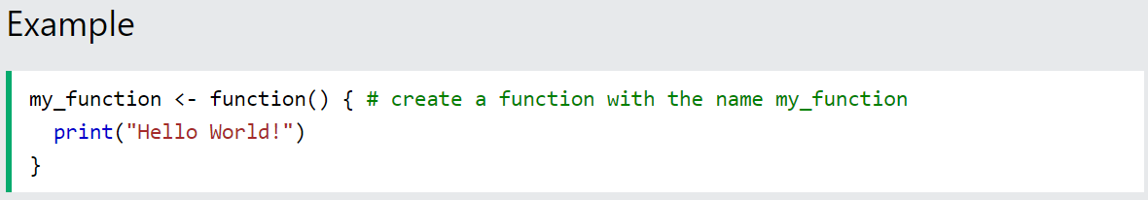
Creating a Function
To create a function, use the function() keyword:

Slide 4
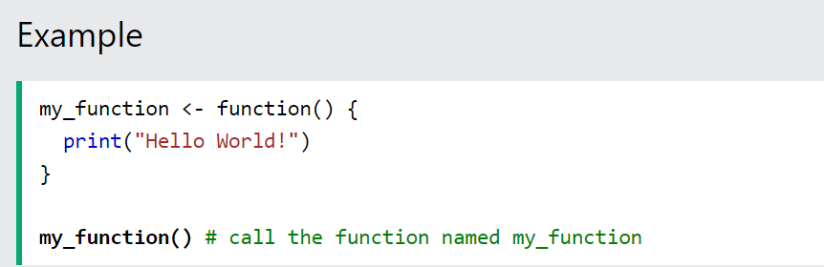
Call a Function
To call a function, use the function name followed by parenthesis, like my_function():

Slide 5
Arguments
Information can be passed into functions as arguments.
Arguments are specified after the function name, inside the parentheses. You can add as many arguments as you want, just separate them with a comma.
The following example has a function with one argument (fname). When the function is called, we pass along a first name, which is used inside the function to print the full name:

Slide 6
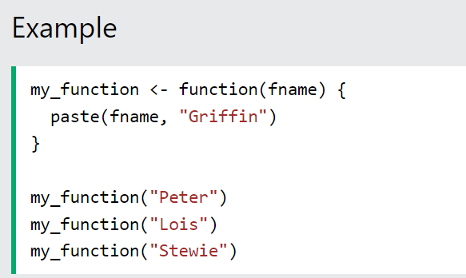

Slide 7
Number of Arguments
By default, a function must be called with the correct number of arguments. Meaning that if your function expects 2 arguments, you have to call the function with 2 arguments, not more, and not less:

Slide 8
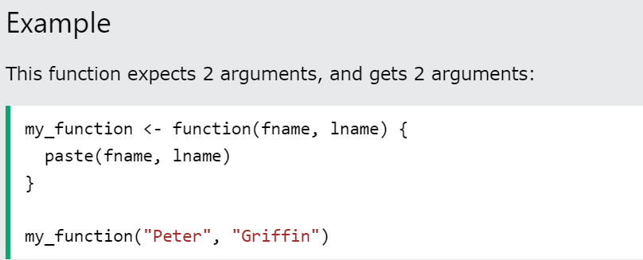

Slide 9
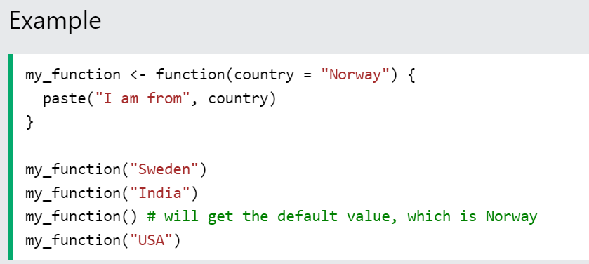
Default Parameter Value
The following example shows how to use a default parameter value.
If we call the function without an argument, it uses the default value:

Slide 10
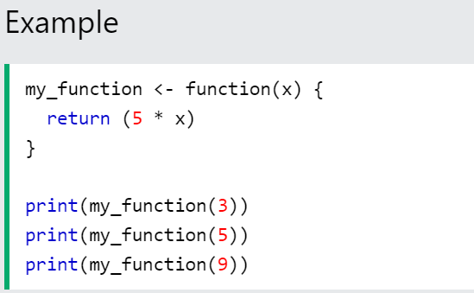
Return Values
To let a function return a result, use the return() function:

